Slide 1
CERAMICS
Inorganic, non-metallic materials prepared by heating at high temperature and subsequent cooling.

Slide 2
Characteristics
May be crystalline, partly crystalline, or amorphous
Prepared from earthly raw material predominantly Silicon and its oxides and complex compounds called Silicates
Raw materials for different ceramics include Sand, Clay, Iron, Quartz
Most ceramics are Crystalline, so commonly known as in-organic non-metallic crystalline materials
Manufacture needs heating at high temperature followed by cooling.
Brittle, hard, strong in compression, weak in shearing, tension
Can withstand high temperature and chemical erosion

Slide 3
TYPES / VARIETIES
GROUP
EXAMPLES
Structural
Glass
Refractories
White wares
Abrasive materials
Cement, lime
Porcelain Enamels
Tile, brick
All types of glass
Kiln lining, silica
Dinnerware
Silicon carbide
Plaster, gypsum
Vitreous inorganic coating with a glass like fire polished surface

Slide 4
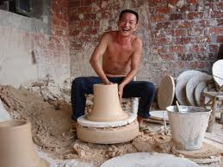

Slide 5
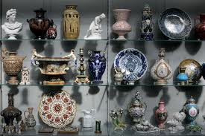

Slide 6
APPLICATIONS OF CERAMICS
Knife blades
Brake disks
Integrated circuits store data in computer permanently
As thin coating on conventional objects e.g. Titanium nitride
As ball bearings in place of steel
Armored fighting vehicles because of high resistance

Slide 7
PLASTICS
Synthetic organic materials of high molecular weight that are moldable i.e. they can be shaped in any form under heat.

Slide 8
Characteristics
Chemical resistant
Electrical insulator
Light weight
Transparent
Water resistant
Non-allergic
Fungus resistant

Slide 9
Composition
Organic polymers
Polymer: macromolecule formed by chemical union of monomers
Monomer: identical units
Most are composed of chains of Carbon alone or Oxygen, Sulfur ,Nitrogen
Backbone: large number of monomers repeat together
Side chain: arrangement determine properties
Additives: in-organic compounds added for various purposes e.g. fillers, stabilizer. 0 to 50 % . On average 20 %

Slide 10
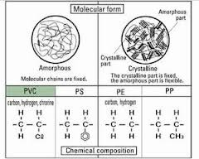

Slide 11
Classification
Thermosetting plastics
Thermoplastics
Can be melted only once
After melting they harden
Undergo irreversible chemical reaction and thus chemical change
Examples:
Polyesters
silicones
Can be melted again and again
Chemical structure is not changed on heating
Examples:
Nylons
Teflon
Polystyrene
polyethylene

Slide 12
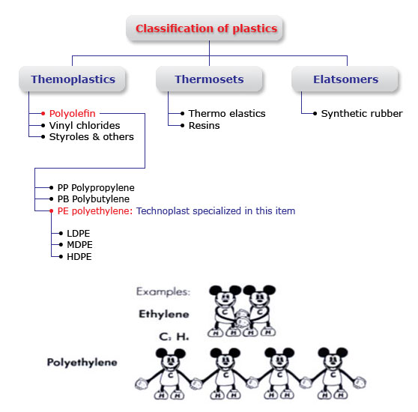

Slide 13
TYPES: Resin identification codes
PET: Polyethylene Terephthalate
HDPE: High Density Polyethylene
PVC: Polyvinylchloride
LDPE: Low Density Polyethylene
PP: Polypropylene
PS: Polystyrene
Others

Slide 14
USES
PVC: Pump parts, pipe fitting, window frames
Polyethylene: transparent sheets, baskets, food containers, toys
Polystyrene: house wares, packing, disposable cups plates
Teflon: pipe and tank lining, pump components
Polyesters: fiber, textile
Polypropylene: bottle caps, drinking straws

Slide 15
ELECTRICITY
Fast moving electrons
Popular form of energy
Can be converted in to many forms of energies
On basis of electrical properties materials may be
Conductors
Insulators
Semi-conductors

Slide 16
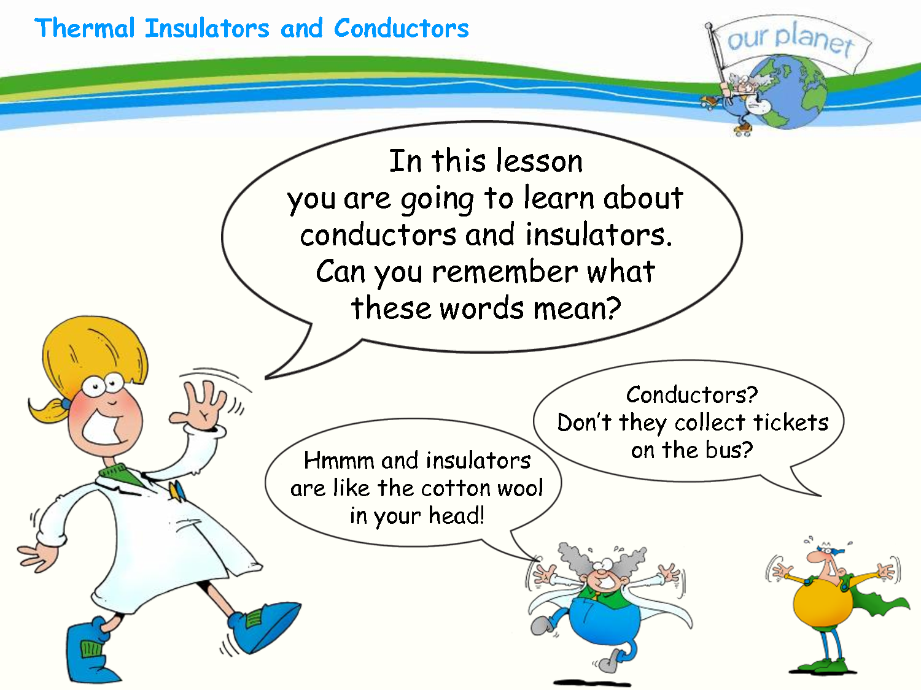

Slide 17
Conductors
Materials which allow flow of electrical charges in one or more directions.
Moveable charged particles are Electrons
Electricity to pass through them easily without much resistance
Most metals are conductors e.g. Copper, Iron, Silver

Slide 18
Insulators
Materials which do not conduct electrical current under influence of an electrical field
Do not allow electricity to pass through them
Their internal charges do not flow freely
Pure insulator do not exist: but some material have high resistivity and thus are good insulator
Examples: glass, paper

Slide 19
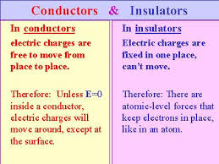

Slide 20
Semi-conductors
Material having electrical conductivity to a degree between a conductor and an insulator
Allow electricity to pass through only partially.
Has ability of changing conductivity by addition of impurities
Foundation of modern electronics including transistors, integrated circuits
Examples: silicon carbide, selenium

Slide 21
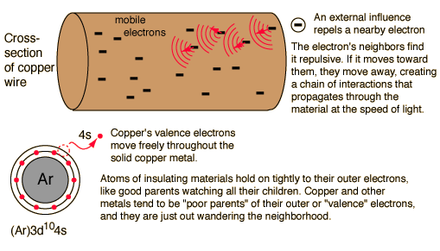

Slide 22
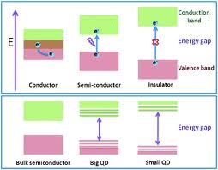

Slide 23
Doping
Process of addition of impurities to semi-conductors to boost their conducting properties
N and P type semi-conductors are thus obtained
Dopant may be electron DONOR or ACCEPTOR

Slide 24
TYPES
N-type
P-type
Formed when pure semi-conductors doped with electron-DONOR impurity
Electrons act as charge carrier
Example: silicon doped with arsenic
Formed when semi-conductor is doped with electron-DEFICIENT impurity
Conduction takes due to motion of holes which act like positive charge
Example: silicon doped with Boron

Slide 25
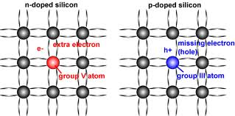

Slide 26
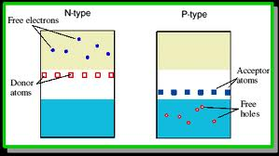

Slide 27
General characteristics
Increase in electrical conductivity with increase in temperature
Properties follow from structure of material
Can be doped with selected impurities to achieve desired properties
Functioning of semi-conductors involves Solid state Physics
Examples: Silicon, Selenium, Germanium
Examples of impurities: arsenic, antimony, Boron

Slide 28
Superconductor
A material that offers no resistance to electrical current
No material on the Earth carries that property at ordinary temperatures
Materials when super-cooled turn into super-conductors
MRI machines use super-conductors
Bednorz and Muller; Nobel prize in Physics for discovering a super-conductor mixture if Lanthanum, copper, Barium, and Oxygen

Slide 29
Diode
Two terminal electronic device having asymmetrical conductance i.e. low resistance in one direction and high resistance in other direction
Crystalline piece of semi-conductor material with P-N junction connected to two electrical terminals.
Most diodes are composed of Silicon, but other semi-conductors such as Selenium are also sometime used

Slide 30
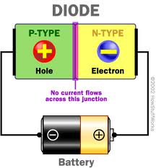

Slide 31
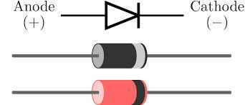

Slide 32
Uses / Functions of Diodes
Allow passage of current in one direction and block in other direction, thus used in converting A.C to D.C
Used as temperature sensor and voltage reference
As voltage regulator
Used to electronically tune radio and TV receivers
To produce light
To generate high frequency oscillations

Slide 33
DIFFERENCES
VACCINE
ANTIBIOTIC
Substances used to prevent disease
Do not kill micro-organisms
Used according to schedule at fixed interval
Examples: polio, Hepatitis B, Measles vaccines
Chemical which either kill or retard growth of micro-organisms
Kill micro-organisms
Used frequently according to requirement
Ceftriaxone , Ciprofloxacin

Slide 34
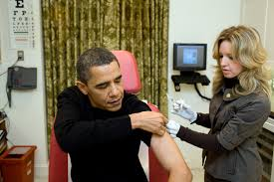

Slide 35
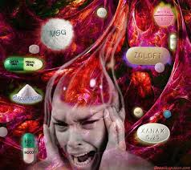

Slide 36
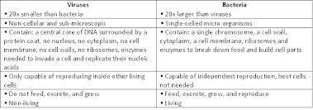

Slide 37
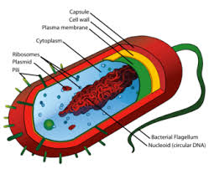

Slide 38
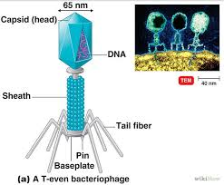

Slide 39
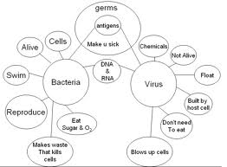

Slide 40
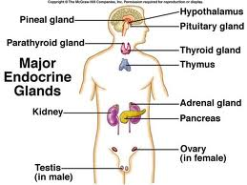

Slide 41
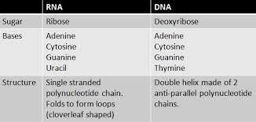

Slide 42
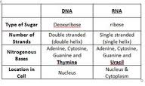

Slide 43
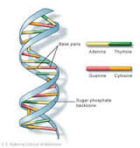

Slide 44
